Slide 1
The Composite Pattern (Structural)

Slide 2
Motivation
Many computer applications involve hierarchical, tree-structured data where the leaf nodes are considered primitives and the interior nodes are composites consisting of primitives and other composites.
This approach to structuring data is sometimes called recursive composition.
Basic Idea: Clients should be able to handle both composites and primitives in a similar manner.

Slide 3
Motivation (continued)
Examples
In a file system, directories (folders) can contain several entries, where each entry can be either a “plain” file or another directory.
In a graphics application, a user can group several graphics primitives to form a larger graphics component, which can, in turn, be grouped with other primitives and groups.
An XML document can be viewed as a hierarchical document consisting primarily of elements and text, where the elements can contain other elements and/or text.
An arithmetic expression can be viewed as a tree, where the interior nodes are the operators and the leaves are the operands.

Slide 4
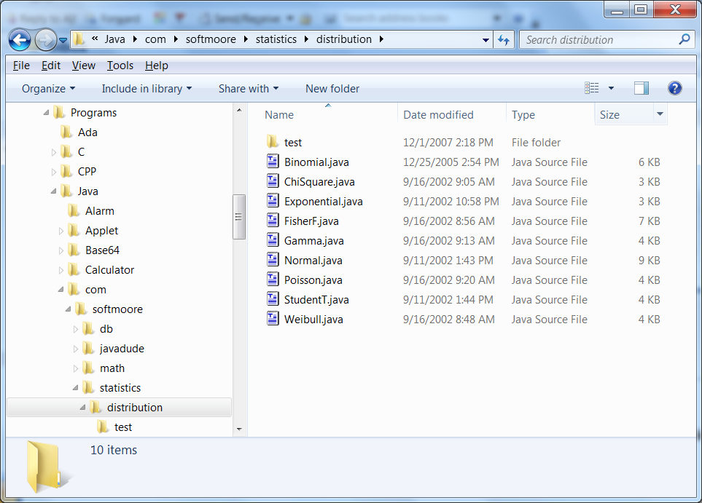
Composite Example 1: File System

Slide 5
Composite Example 2: XML
<?xml version="1.0"?>
<!DOCTYPE greeting SYSTEM "Greeting.dtd">
<greeting language="English">
<salutation>Hello</salutation>
<delimiter>, </delimiter>
<target>world</target>
<endPunctuation>.</endPunctuation>
</greeting>

Slide 6
Viewing Example 2 as a Tree
greeting
markup
salutation
delimiter
target
endPunctuation
content
Hello
,
world
.

Slide 7
Composite Example 3: Arithmetic Expression
+
2
∗
3
5

Slide 8
Composite Pattern
Intent: Compose objects into tree structures to represent whole-part hierarchies. Composite lets clients treat individual objects and compositions of objects uniformly.
Applicability: Use the Composite pattern to
represent part-whole hierarchies of objects
allow clients the ability to ignore the difference between composition of objects and individual objects. Clients will treat all objects in the composition structure uniformly.

Slide 9
Composite Pattern (continued)
Structure
Composites that contain Components, each of which could be a Composite.
Component
operation()
add(Component)
remove(Component)
children() : Iterator
Client
*
Leaf
operation()
Composite
operation()
add(Component)
remove(Component)
children() : Iterator
1
for all c in children
c.operation()

Slide 10
Composite Pattern Participants
Component (abstract class)
declares interface for objects in the composition.
implements default behavior common to all classes, as appropriate.
declares an interface for accessing and managing its child components.
(optional) defines an interface for accessing a component’s parent in the recursive structure.
Leaf
represents leaf objects in the composition (no children).
defines behavior for primitive objects in composition.

Slide 11
Composite Pattern Participants (continued)
Composite
defines behavior for components having children.
stores child objects.
implements child-related operations defined in Component by delegating to all child objects.
Client
manipulates objects in the composition through the Component interface.

Slide 12
Composite Pattern Collaborations
Clients use the Component class interface to interact with objects in the composite structure.
If the recipient is a Leaf, then the request is handled directly.
If the recipient is a Composite, then it usually forwards requests to its child components, possibly performing additional operations before and/or after forwarding.

Slide 13
Composite Pattern Consequences
defines class hierarchies consisting of primitive objects and composite objects. Primitive objects can be composed into more complex objects, which in turn can be composed, and so on recursively.
makes the client simple. Clients can treat composite structures and individual objects uniformly.
makes it easier to add new kinds of components. Clients don’t have to be changed for new Component classes.
makes it harder to restrict the components of a composite – must use run-time checks.

Slide 14
Composite Pattern Implementation Issues
Explicit parent references.
simplify moving up in the structure
usually defined in the Component class
Sharing components.
difficult if a component can have no more than one parent
Maximizing the Component interface.
simplifies the client, but there are many operations that are not meaningful for Leaf classes
helpful to sometimes view a Leaf as a Composite that never has any children

Slide 15
Composite Pattern Implementation Issues (continued)
Declaring the child management operations.
Should the add() and remove() operations be declared in Component or Composite?
Decision involves tradeoff between safety (declared in Composite) and transparency (declared in Component)
GoF design emphasizes transparency over safety.
Child Ordering
must design child access and management interfaces to manage the sequence of children.

Slide 16
Composite Example 1 Revisited
AbstractFile
delete()
...
*
File
delete()
...
Directory
delete()
...
1
for all c in children
c.delete();
deleteSelf();
Note: Most file systems also allow links (a.k.a., shortcuts)
as another type of file component; i.e., another subclass of
AbstractFile. A link would be an example of the Proxy pattern.

Slide 17
Composite Example 1 Revisited (continued)
Object (instance) diagram
: Directory
: File
: Directory
: File
: File
: Directory
: File
: File
: File
: File

Slide 18
Composite Pattern in Java – AWT
In the AWT GUI classes, class Container extends the abstract class Component. Any Component can be added to a Container, including another Container.
For example, a Panel is a container that can contain buttons, text fields, labels, and other panels.

Slide 19
Composite Pattern in Java – Files
Java has a class File that implements a variation on the Composite pattern.
Class File is used to represent both ordinary files and directories. Methods isDirectory() and isFile() can be used to determine which one is being represented.
Structure
*
File
1

Slide 20
Traversing Composite Hierarchies
Composites are recursively-defined data structures and can often be traversed using recursive algorithms.
Example: Computes disk space for file or directory.
public static long diskSpace(File file)
{
long space = file.length();
if (file.isDirectory())
{
for (File f : file.listFiles())
space += diskSpace(f);
}
return space;
}

Slide 21
Rethinking the Composite Pattern
The main criticism of the Composite as it appears in the GoF book is that the Component interface is fat; i.e., it contains several methods that deal with children and are applicable only to Composite classes, not Leaf classes.
In a context involving an arbitrary component object, it doesn’t make sense to call method add() unless you know that the component object is a Composite. The GoF pattern gives a uniform interface, but the methods in the interface aren’t applicable to every subclass. Frequently there is a need to distinguish between Composite objects and Leaf objects at runtime.
if (component instanceOf Composite)
... // safe to call method add()

Slide 22
Rethinking the Composite Pattern: Alternate Structure 1
Structure
Component
operation1()
operation2()
Client
*
Leaf
operation1()
operation2()
Composite
operation1()
operation2()
add(Component)
remove(Component)
children() : Iterator
1
for all c in children
c.operation1()

Slide 23
Rethinking the Composite Pattern: Alternate Structure 2
Structure
Component
operation()
children() : Iterator
Client
*
Leaf
operation()
AbstractComposite
operation()
add(Component)
remove(Component)
children() : Iterator
Composite
operation()
add(Component)
remove(Component)
children() : Iterator
1
for all c in children
c.operation()

Slide 24
Related Patterns
Often the component parent link is used for a Chain of Responsibility.
Decorator is often used with Composite. When decorators and composites are used together, they will usually have a common parent class.
Iterator can be used to traverse composites.
Visitor localizes operations and behavior that would otherwise be distributed across Composite and Leaf classes.

Slide 25
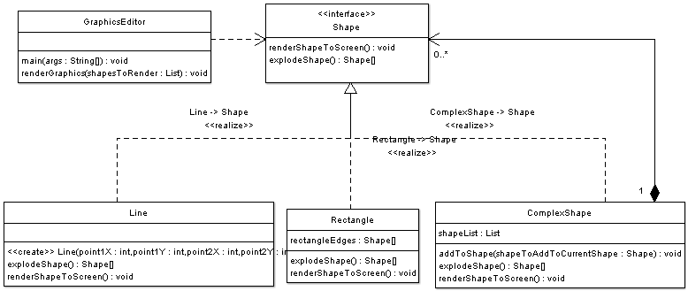
Composite Pattern: Example (http://www.oodesign.com/composite-pattern-shapes-example-java-sourcecode.html)

Slide 26
References
Composite pattern (Wikipedia)
http://en.wikipedia.org/wiki/Composite_pattern
A look at the Composite design pattern (David Geary, JavaWorld)
http://www.javaworld.com/javaworld/jw-09-2002/jw-0913-designpatterns.html
Composite Design Pattern (SourceMaking)
http://sourcemaking.com/design_patterns/composite
The Composite Pattern (Bob Tarr)
http://userpages.umbc.edu/~tarr/dp/lectures/Composite-2pp.pdf
COMPOSITE à la Java, Parts I & II (John Vlissides)
http://www.research.ibm.com/designpatterns/pubs/jr-jun01.pdf
http://www.research.ibm.com/designpatterns/pubs/jr-sep01.pdf

